Slide 1
Car price
prediction

Slide 2
Ai ml project
Project name: Car Price Prediction
Programming tools: Python, Jupyter Notebook
Presented to: Shinnu Mam & Tushar Sir
Presented by: Kritika Bansal (2210990524)

Slide 3
introduction
Machine learning techniques offer promising solutions to this challenge by leveraging historical data and extracting meaningful patterns to forecast future prices.
In this project, we delve into the realm of machine learning for car price prediction. By harnessing the power of advanced algorithms, we aim to build a predictive model capable of estimating the prices of cars based on a set of relevant features. Using Linear Regression, Lasso Regression, Matplotlib (Scatter Plot), etc.
Estimate pre owned car prices by analysing present price, kilo meters driven, fuel type, transmission etc.

Slide 4
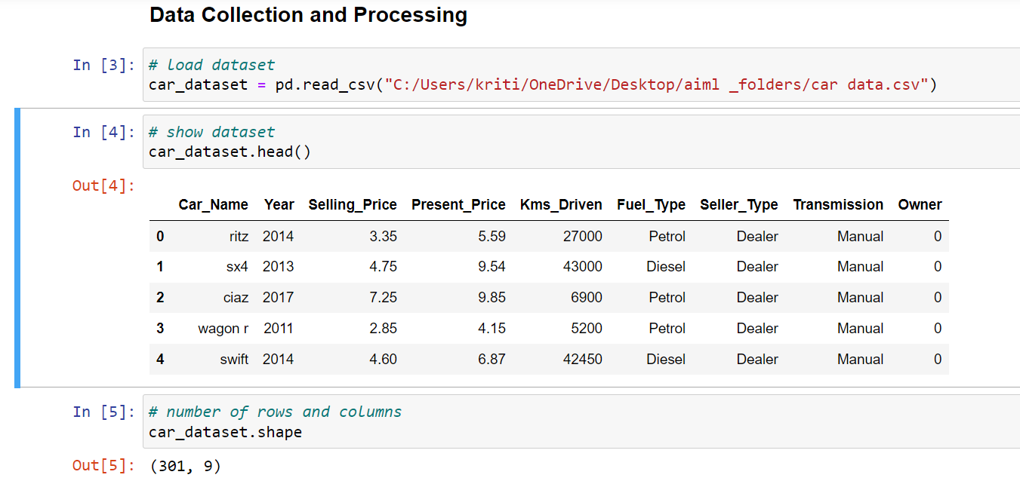
Dataset collection
By analyzing these features collectively, we aim to build a predictive model that accurately estimates the selling price of cars based on their various attributes.
Through data-driven insights, we seek to enhance understanding of the factors driving car prices and empower stakeholders in the automotive industry to make informed decisions regarding pricing, marketing, and inventory management.

Slide 5
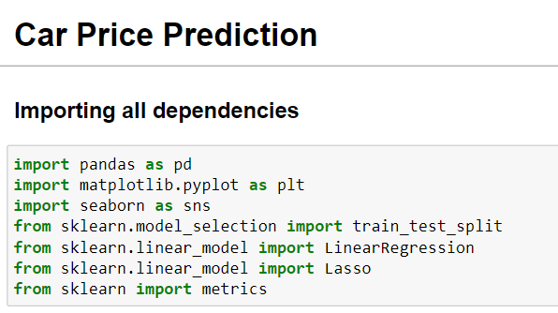
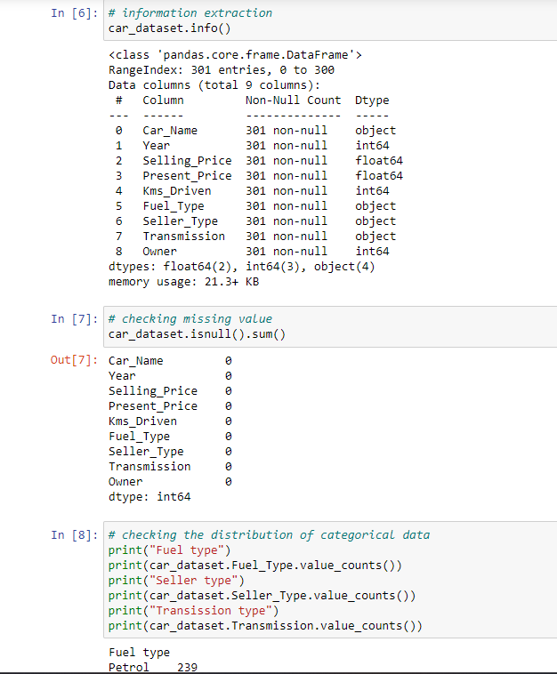
Data preprocessing
Importing necessary libraries: Importing Pandas, Matplotlib, Seaborn, and other required libraries.
Loading dataset: Using Pandas to load the dataset into the Data Frame.
Exploring the dataset: Using methods like head(), info(), and describe() to understand the structure and contents of the dataset.
Data cleaning: Removing duplicates, outliers, or any inconsistencies in the data.

Slide 6
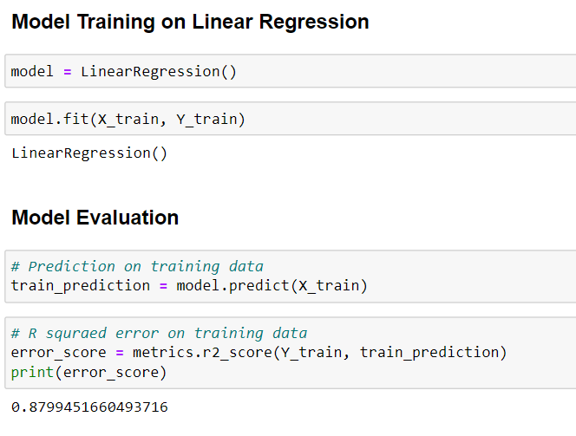
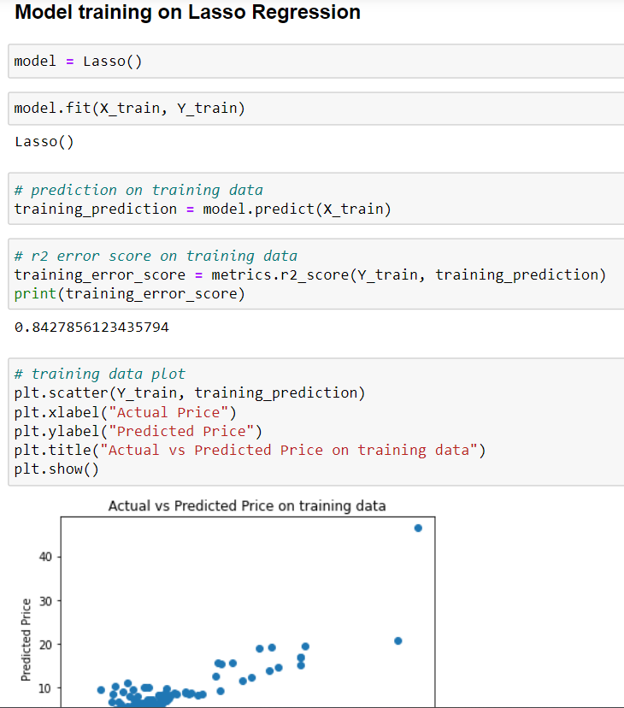
Model selection & training
Splitting the dataset: Splitting the dataset into training and testing sets to train the model and evaluate its performance.
Choosing machine learning algorithm: Selecting appropriate algorithms such as Linear Regression or Lasso Regression based on the problem and data characteristics.
Model training: Training the chosen model using the training dataset.

Slide 7
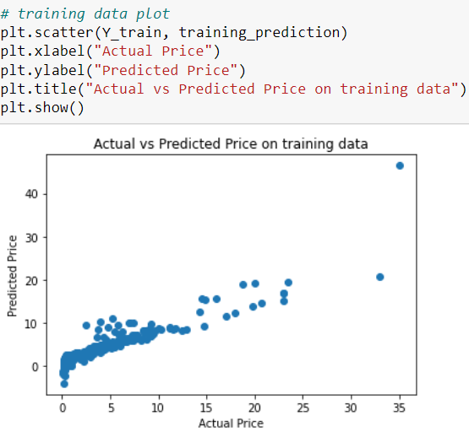
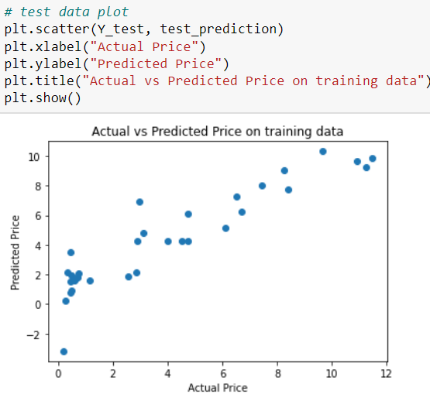
visualization
In addition to numerical metrics, we visualize the performance of our model using plots.
One such plot is the scatter plot of actual versus predicted prices on the test data. This visualization provides insights into how well our model performs across different price ranges and helps identify any systematic errors or biases.

Slide 8
conclusion
By combining the principles of machine learning with domain knowledge in the automotive industry, we aim to develop a robust and reliable car price prediction model.
Such a model not only facilitates informed decision-making for car buyers and sellers but also contributes to the advancement of data-driven approaches in the automotive sector.
Through this project, we hope to demonstrate the practical utility of machine learning in addressing real-world challenges and driving innovation in the automotive market.

Slide 9
References & links
Car data.csv
Libraries used:
Pandas
matplotlib.pyplot
seaborn
from sklearn.model_selection (train_test_split)
from sklearn.linear_model (LinearRegression)
from sklearn.linear_model (Lasso)
from sklearn (metrics)
https://www.kaggle.com/code/cagkanbay/car-price-prediction
https://medium.com/analytics-vidhya/linear-regression-a-z-using-car-price-prediction-dataset-e32b50c7a561

Slide 10
THANK YOU

